Slide 1




How are bonds formed? ● Bonding & Attachment ● Tips to strengthen bonds ● Need A Hand?
Dr.Ajay Sharma
Neuro-developmental Pediatrician
Attachment and Bonding

Slide 2

How are bonds formed? ● Bonding & Attachment ● Tips to strengthen bonds ● Need A Hand?
Dr.Ajay Sharma
Neuro-developmental Pediatrician
Why is bonding important?
The bond between a parent and a child directly impacts the way a child interacts with the world around them.
A child who has a loving bond with their parents, tend to deal with stressors better.
A parent and child’s relationship strengthens as the parents responds to the child’s needs through affection, sensitivity and providing a soothing response when they are unhappy.
Dr.Ajay Sharma
Neuro-developmental Pediatrician

Slide 3
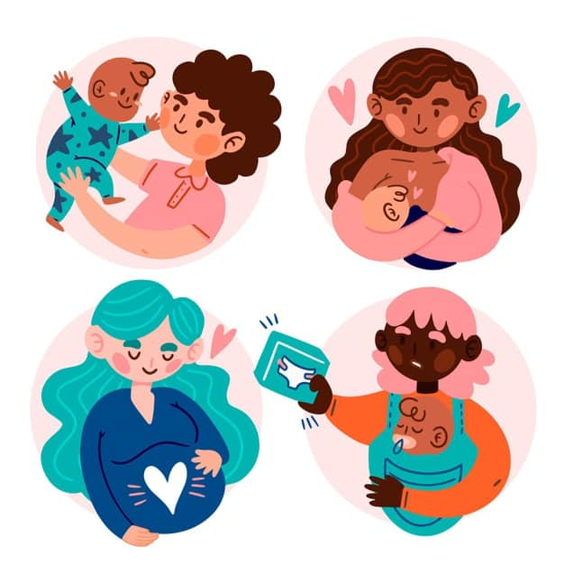
How are bonds formed? ● Bonding & Attachment ● Tips to strengthen bonds ● Need A Hand?
Dr.Ajay Sharma
Neuro-developmental Pediatrician
Difference In Bonding & Attachment
Bonding is about the strong surge of feelings mothers feel, during the pregnancy or after the birth, towards their baby.
Attachment is about the baby feeling safe and secure in the relationship with their parents.
Dr.Ajay Sharma
Neuro-developmental Pediatrician

Slide 4



How are bonds formed? ● Bonding & Attachment ● Tips to strengthen bonds ● Need A Hand?
Dr.Ajay Sharma
Neuro-developmental Pediatrician
Bonding & attachment at different ages
7 months
The infant shows selective attachment to the primary caregiver, often the mother.
Infant is happy when the caregiver is present, but distressed when the caregiver leaves.
3-4 years
Able to explore, bond and be happy around familiar adults (grandparents, siblings, aunts and uncles)
Are able to communicate their feelings through words and eye contact.
4-5 years
They are comfortable with non-familiar adults and peers.
Are able to interact with new people.
Dr.Ajay Sharma
Neuro-developmental Pediatrician

Slide 5

How are bonds formed? ● Bonding & Attachment ● Tips to strengthen bonds ● Need A Hand?
Dr.Ajay Sharma
Neuro-developmental Pediatrician
Factors influencing bonding & attachment
Stressors in a parent’s life
Parent - Child Relationship
Life Experiences of the Parent
Parent’s & child’s personality traits
Dr.Ajay Sharma
Neuro-developmental Pediatrician

Slide 6
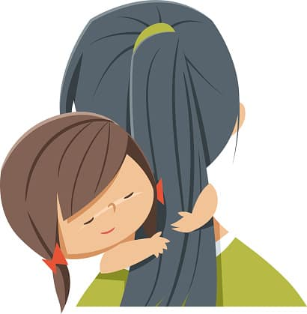
How are bonds formed? ● Bonding & Attachment ● Tips to strengthen bonds ● Need A Hand?
Dr.Ajay Sharma
Neuro-developmental Pediatrician
Tips to Strengthen Parent – Child Bonds
Show Affection
Be Direct
Have
Fun
Open various modes of Communication
Be Mindful
Dr.Ajay Sharma
Neuro-developmental Pediatrician

Slide 7
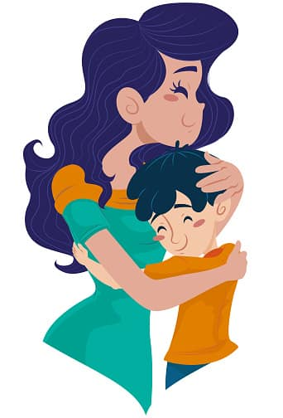
How are bonds formed? ● Bonding & Attachment ● Tips to strengthen bonds ● Need A Hand?
Dr.Ajay Sharma
Neuro-developmental Pediatrician
Tips to Strengthen Parent – Child Bonds
  Hug and cuddle your child.
  A pat on the back for a job well done goes a long way.
  Smile at your child when they are enthusiastic or showing you something of importance to them.
1. Show Affection
Dr.Ajay Sharma
Neuro-developmental Pediatrician

Slide 8
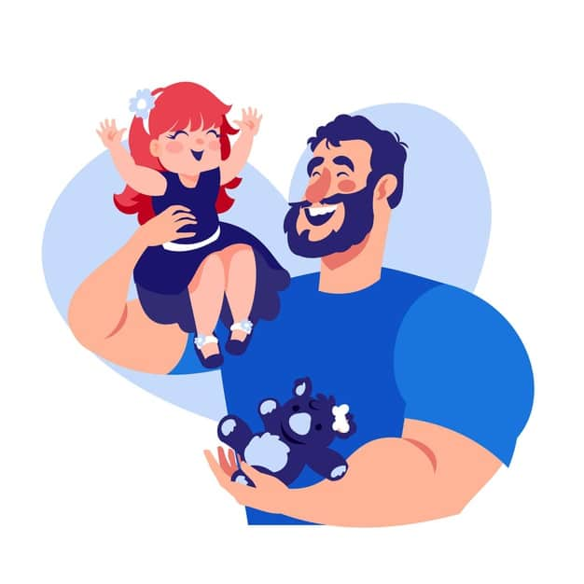
How are bonds formed? ● Bonding & Attachment ● Tips to strengthen bonds ● Need A Hand?
Dr.Ajay Sharma
Neuro-developmental Pediatrician
Tips to Strengthen Parent – Child Bonds
Plan fun activities for together.
Play is an easy & fun
way to bond.
Make reading a book fun with gestures.
Do puzzles or sing rhymes together.
2. Have Fun
Dr.Ajay Sharma
Neuro-developmental Pediatrician

Slide 9
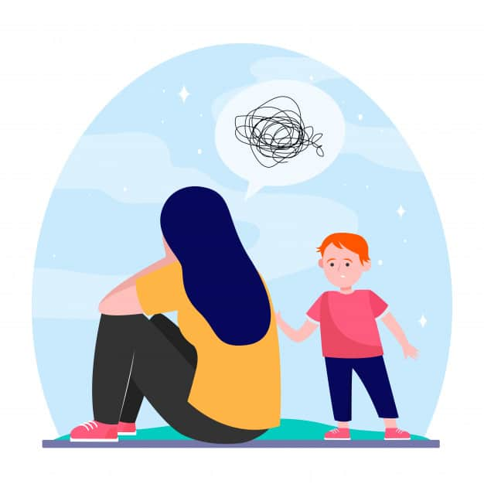
How are bonds formed? ● Bonding & Attachment ● Tips to strengthen bonds ● Need A Hand?
Dr.Ajay Sharma
Neuro-developmental Pediatrician
Tips to Strengthen Parent – Child Bonds
Actively listen to your child
Talk in short and clear sentences
Explain your feelings
Use every opportunity to engage them in conversation.
When planning activities, ask them about what they would want to do rather than enforcing your choice.
3. Open Communication
Dr.Ajay Sharma
Neuro-developmental Pediatrician

Slide 10
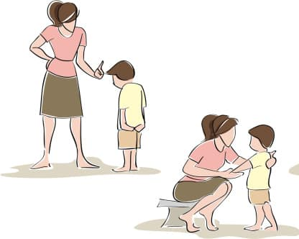
How are bonds formed? ● Bonding & Attachment ● Tips to strengthen bonds ● Need A Hand?
Dr.Ajay Sharma
Neuro-developmental Pediatrician
Tips to Strengthen Parent – Child Bonds
Be clear about what the child did wrong when you correct them.
Have fixed ground rules and make sure your you condition them to learn what is appropriate and what is not.
4. Be Direct While Disciplining
Dr.Ajay Sharma
Neuro-developmental Pediatrician

Slide 11

How are bonds formed? ● Bonding & Attachment ● Tips to strengthen bonds ● Need A Hand?
Dr.Ajay Sharma
Neuro-developmental Pediatrician
Tips to Strengthen Parent – Child Bonds
Avoid harsh or hostile remarks
Do not end conversations when you both are still angry
Do not engage in any violent behaviours
Do not threaten to self harm or leave while blaming the child.
Do not allow your relationship problems impact your relationship with the child.
5. Be Mindful Of Your Own Behaviour
Dr.Ajay Sharma
Neuro-developmental Pediatrician

Slide 12

How are bonds formed? ● Bonding & Attachment ● Tips to strengthen bonds ● Need A Hand?
& parents
are here to help!
Nayi Disha’s parent WhatsApp groups & monthly support groups
are here
for all your doubts regarding raising a special-needs child.
To join the parent community &/or for more information,
write to us:
contactus@nayi-disha.org & visit nayi-disha.org for more resources on Menstrual care & health of your child.

